Slide 1
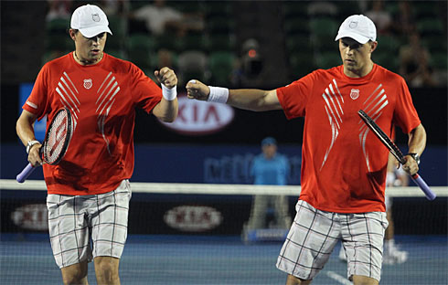
Linguistic Reasoning in Collaborative Mobile Robots
Sophia Mitchell and Dr. Kelly Cohen
University of Cincinnati
Notes:
Hello! I’m Sophia Mitchell, and I worked with Dr. Kelly Cohen on Linguistic Reasoning for Collaborative Mobile Robots. Before I get started I’d like to show a short video that encompasses the motivation behind this research.

Slide 2

Outline
Vision
Objective
Approach
Development Process
Results
Conclusions
Recommendations
Bibliography
Notes:
Today I will begin by introducing our vision and objective for this research, and then our approach. Finally I will present our results, conclusions, and recommendations for future work.

Slide 3
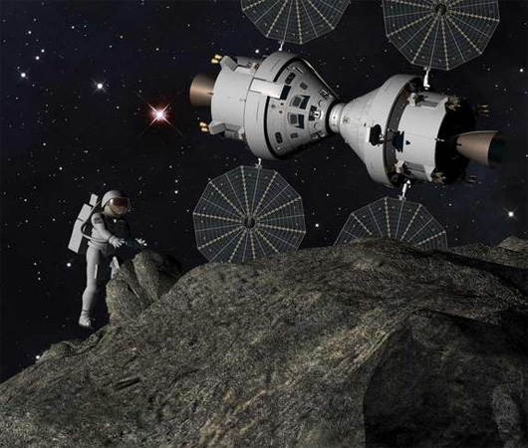



Vision
“By 2025 we expect new spacecraft designed for long journeys to allow us to begin the first ever crew missions beyond the Moon into deep space,” President Obama, April 15, 2010
Notes:
President Barak Obama stated on April 15, 2010 that by 2025 we will send human missions to the asteroids and later to Mars and beyond to deep space.

Slide 4
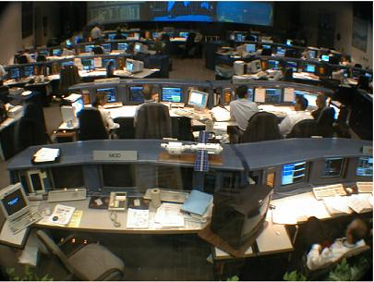
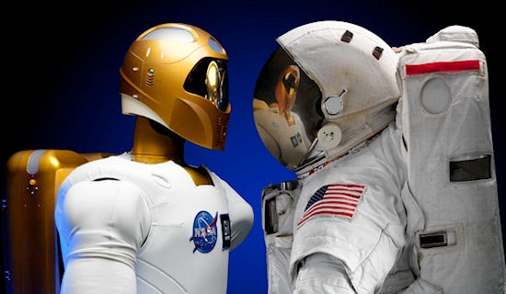
Overall Objective
Mission Control
Exploring and exploiting the interactions between humans and intelligent robots to create a synergetic team.
Notes:
My long term research objective is to make the most of the interactions between humans and intelligent robots by creating a team that works as a well oiled machine. This team would include robots, whose minds would work as a mission control, traveling with the human astronauts on their missions.

Slide 5
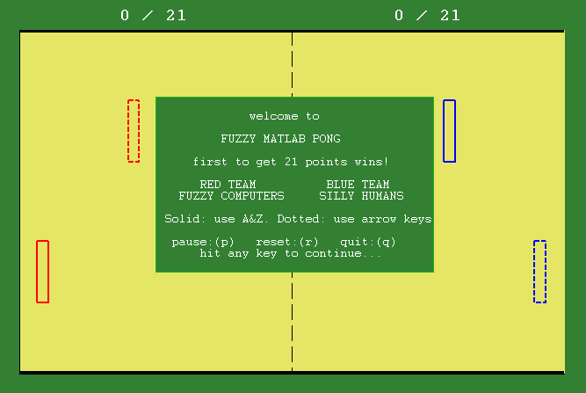
Research Objective
Develop a collaborative robotic team to work effectively in an uncertain spatio-temporal environment.
Human players provide uncertainty.
Collaborative robots
Notes:
For this summer’s WiSE REWU program, our goal was to develop a collaborative robotic team that works effectively in an uncertain spatio-temporal environment. Here is a screenshot of the simulation, with the collaborative robots in red on the left, and the unpredictable human players in blue on the right.

Slide 6
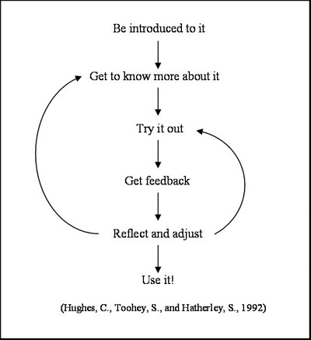
Simulation Environment
PONG
Uncertainty
Common goal
Real-time gameplay
Expert Knowledge
Similarities to Tennis
Notes:
The simulation environment we chose to use was a MATLAB version of the ATARI game, PONG. We chose this for several reasons including the uncertainty and real-time gameplay that are natural aspects of PONG. I was also able to easily gain expert knowledge of the game using the carrot-and-stick method, and then using these winning strategies for programming.

Slide 7

Fuzzy Logic
Allows classification of variables for more human-like reasoning.
Common terms
Inputs
Rules
Outputs
Membership Function
Fuzzy Inference System (FIS)
Notes:
Fuzzy logic allows for classification of variables for more human-like reasoning. Normally programming uses binary logic, where things are ones, and zeros, red or yellow. As humans, using this type of reasoning in everyday life wouldn’t make much sense because we know there are numbers between zero and one, or colors between red and yellow. To us, things are in a continuum. The beauty of fuzzy logic is if I were to ask everyone in this room to point to orange on this spectrum, “orange” would suddenly become several different points with varying degree of belonging to red and yellow, and we would all be correct. *pause* Now let’s just reflect upon what you see here… the color spectrum. This is life. In all it’s richness and color. Life is fuzzy, and we need to embrace that fact.

Slide 8
Fuzzy Decision Making
1
IF (Far Above) THEN (Fast Up)
Fast Up
IF (Above) THEN (Up)
Up
OUTPUT
IF (Target) THEN (Stay)
Stay
IF (Below) THEN (Down)
Down
IF (Far Below) THEN (Fast Down)
Fast Down
-1
Far Below
Below
Target
Above
Far Above
-100
INPUT
100
Notes:
This is how fuzzy logic uses linguistics to connect an input to an output. Inputs and outputs are given a certain degree of membership to these five sets. These sets are connected with patches of fuzzy reasoning that tell me, for example that if I’m on target to hit the ball, then stay put!

Slide 9
Research Approach
Situational Awareness
Where? When?
Fuzzy Logic
Simulation
Pong
MATLAB
Decision Making
What? How?
Fuzzy Logic
Notes:
Our approach was to make a system that within our MATLAB Pong simulation would use fuzzy situational awareness to asses where it needed to be and when. Then it was to use fuzzy decision making to decide what strategy to use and how it would get there, and perform the strategy within the simulation, and so on and so forth.

Slide 10
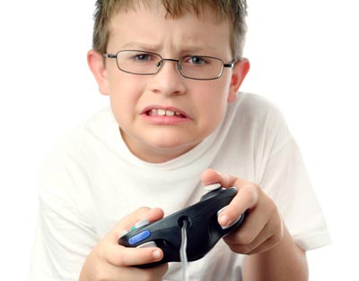
Research Approach
Develop autonomous PONG player
Classify input variables
Create rule sets based off of knowledge
Decide how to use output
Develop doubles PONG
Create second player
Create cascading fuzzy system for decisions between players
Who goes?
What strategy should I use?
http://static.howstuffworks.com/gif/best-games-never-made-6.jpg
Notes:
Our research approach was to start by developing one autonomous PONG player. I had to decide what input variables were needed, create rule sets for the player based off of my expert knowledge, and then decide how to use my output. Next I created a doubles pong game by creating a second autonomous player. For this I also had to create a cascading fuzzy system, which means the output for one fuzzy system becomes the input for another, and so on.

Slide 11
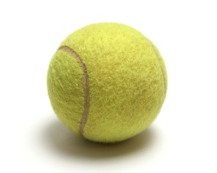
Developing a Singles Fuzzy System
Began with defensive strategy
Inputs
Ball trajectory and speed
Rules
If farther away, go to the ball faster
If closer, slow down
Output
Any number between -1 and 1
If the ball was going away, move to
the center
http://www.recyclethis.co.uk/wp-content/uploads/2006/09/tennis_ball250.jpg
Notes:
To develop the singles fuzzy system, I began with a defensive strategy where the ball hits the center of the paddle. My inputs were the ball’s trajectory and speed, and the output was closer to -1 to move the paddle down, and positive 1 to move the paddle move up. My rules were essentially to move faster when the paddle was further from where the ball will be, and slower as it got closer. If the ball was moving away from the paddle, it was to move to the center to cover the most area.

Slide 12
Singles Pong
Challenges
Missed ball under certain circumstances
Multiple solutions
Final solution – feedback, more situational awareness
Defensive strategy was not enough
Added ability to track other player’s movements
Hits ball to where other player is not
Works very well; very difficult to beat
Robot vs. robot game allowed for in depth error analysis and resolution.
Notes:
Like any research project, we ran into some challenges. First the robot would sometimes blatantly miss the ball. After testing multiple ideas we realized the best solution was to create a feedback loop within the robot, allowing it to check if the ball’s real movement matched the bot’s previously calculated trajectory, and make corrections where needed. We also realized the defensive strategy alone was too easy, so I created a situational awareness for the robot, so it now hits the ball depending on the other player’s location and movement. Now that it works well and is difficult for a human to play, I made a robot vs robot game to allow for more focused analysis.

Slide 13
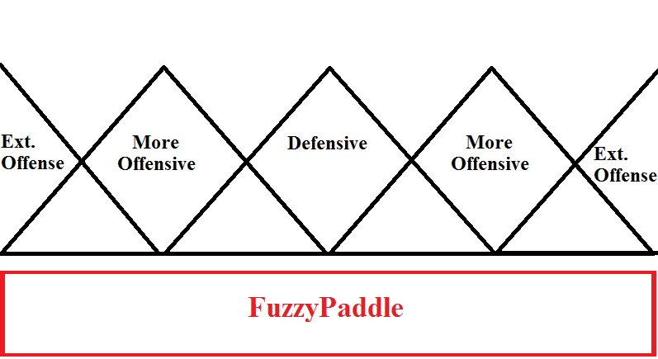
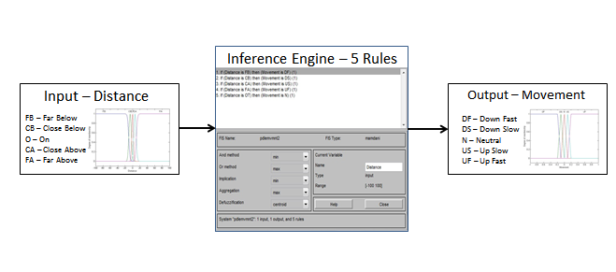
Breakdown of fuzzy paddle offensive and defensive areas.
Paddle Movement FIS (pdlemvmnt2)
Notes:
This first figure depicts how the fuzzy player’s paddle was broken down into offensive and defensive playing areas. As I said before, I originally programmed the paddle only to use its defensive center for playing, however once new strategies were introduced it was then given the ability to play out strategies using the different parts of the paddle.
The second figure is the FIS file that was used for paddle movement. It is easily seen through the output membership functions that the paddle is to move more quickly toward the ball when it is further away from where it will intercept it, and more slowly when it is closer, to allow for smooth movement.

Slide 14
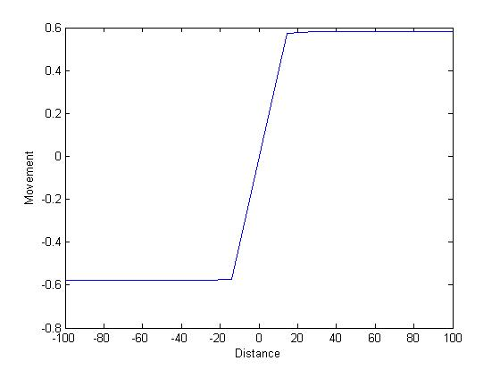
Paddle Movement FIS Output
Notes:
This figure graphically shows the output of the movement FIS file for the singles paddle. This smooth center shows a well working FIS file.

Slide 15
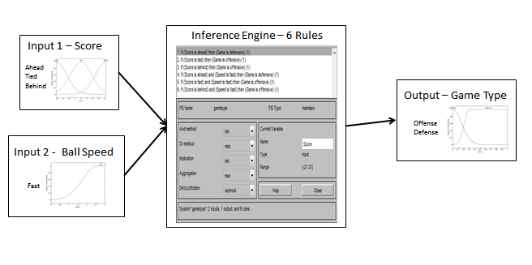
Game Type Calculation FIS (gametype)
Notes:
The second challenge I mentioned was that the paddle needed to have a more difficult playing strategy. To do this, a situational awareness system was made. The situational awareness begins with a “game type” calculation, where the fuzzy player classifies the current game as a more offensive (it’s losing) or defensive (it’s winning) game.

Slide 16
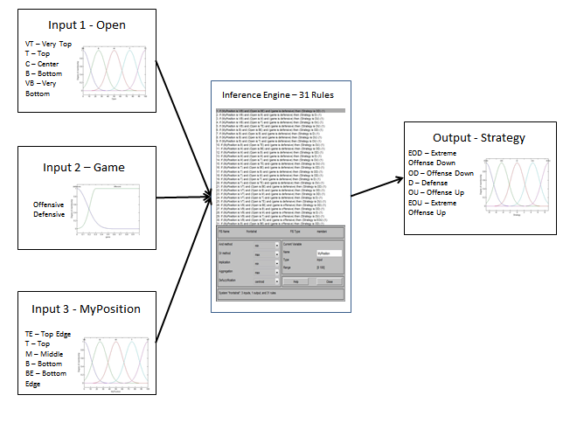
Singles paddle strategy FIS File (oppaware)
Notes:
This game type calculation is then considered along with where the robot’s current location is and where its opponent is not (open). This oppaware FIS file then creates an output, called strategy, which is where the paddle needs to be to perform the best hit for the current situation. This strategy output is then sent to the movement FIS I showed before, which moves the paddle accordingly.

Slide 17

Doubles Pong - FLIP
Meet FLIP: Fuzzy coLlaborative robotIc Pong
Based on doubles tennis
Bryan Bros, and Federer & Mirka
FLIP 2 in front is “leader”
Offensive and defensive moves
Cascading fuzzy logic
Situational awareness
Robot team vs. Robot team
Notes:
Next I created FLIP: Fuzzy collaborative robotic pong. FLIP is based on doubles tennis, mainly games played by the Bryan Bros., who you saw in that first clip, and the Federer & Mirka team. Like in doubles tennis, FLIP 2 in front is the leader, and the team knows offensive and defensive moves. I also created a doubles robot team vs robot team game for analysis once it was hard for humans to play them.

Slide 18
Doubles Pong
When going for the ball…
FLIP 1 paddle placement for:
Conservative offense
Defense
FLIP 2 paddle placement for:
Extreme offense
Conservative offense
Defense
When not going for the ball…
FLIP 1 and 2 have waiting strategies.
Notes:
FLIP 1 and 2 have several strategies for gameplay. FLIP 1 can only use the center of its paddle for conservative offense and defense, as it’s in the back and cannot have much error. FLIP 2 is in front which allows for more error, so it can use extreme offensive moves which use the paddle’s tips. When they aren’t going for the ball, FLIP 1 and 2 both have waiting strategies.

Slide 19
FLIP 1 Distance
FLIP 2 Distance
Who goes?
Get the Ball!
Wait
Determine Ball Hitting Strategy
The Ball Will Go Here.
Perform Ball Hitting Strategy
Perform Wait Strategy
Notes:
This diagram shows the thinking that goes on within the FLIP team. FLIP 1 and 2 determine the distances between where they are and where the ball will intercept their axes, and then FLIP 2 decides who should go. If FLIP 2 is going, it thinks “Ok, GET THE BALL!” determines its strategy, and hits the ball. Meanwhile in this case, FLIP 1 would wait to hear what FLIP 2 is doing, and perform its waiting strategy.

Slide 20
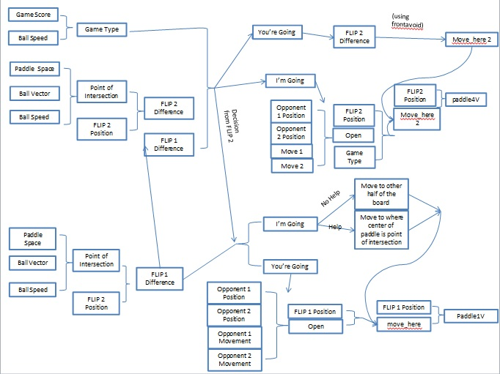
Notes:
What you can see here is a more in-depth look at the collaboration between the FLIP team. This first quadrant is the thinking for FLIP2, below is the thinking for FLIP1, and then to the right you can see each FLIP’s movement or waiting strategies. (Be sure to circle things with your pointer as you say them!) Paddle 1V and paddle 2V are the variables that move the paddle within the game.

Slide 21
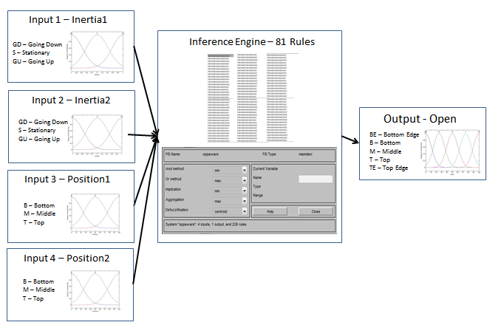
Front paddle situational awareness FIS (oppaware2)
Notes:
This FIS file is used to find where the most open position is for the ball to be hit. The most open position is the point that would be the most difficult for both paddles to get to, due to it either being too far away from both of the paddles, (circle position) or due to the paddles both moving away from that spot (circle inertia). The open output is then sent to the strategy FIS that decides where the paddle should hit the ball.

Slide 22
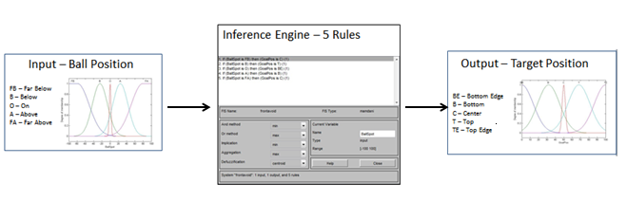
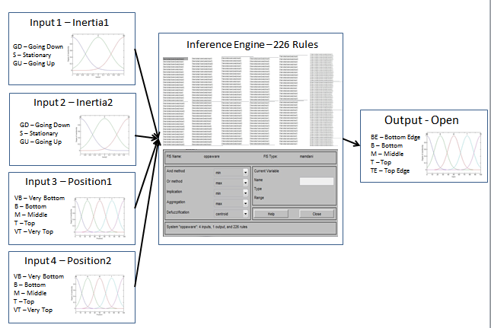
Front Paddle Waiting FIS
Back paddle situational awareness FIS (oppaware)
Notes:
I mentioned that both paddles have waiting strategies. While the back paddle’s is to either go to the other side of the court or back up the paddle in front of it depending on the situation, the paddle in the front has to be sure to get out of the way of the ball so it doesn’t hit the ball backwards and score on itself. This first FIS file is the movement FIS that controls that thinking.
The back paddle has its own situational awareness, since like in real tennis it has more time to strategize what the best play might be. It is essentially the same as the front paddle’s situational awareness that I described before, but it has more layers due to more membership functions and rules.

Slide 23
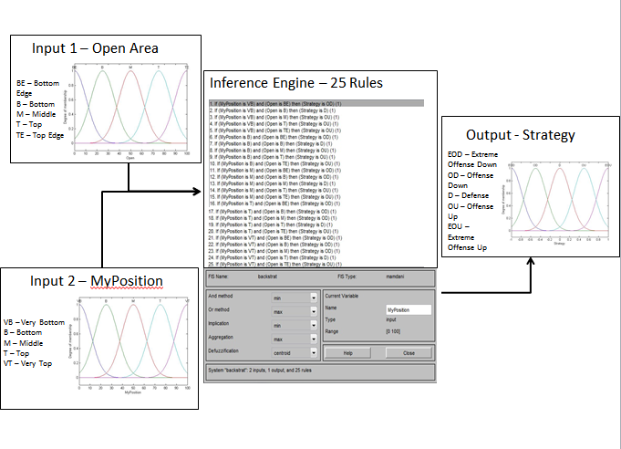
Back paddle movement FIS
Notes:
The front and singles paddles could use the same strategy FIS file, because both had to take into account the game type. The back paddle in the doubles game could have a more simple strategy FIS file, because it would only be getting the ball in defensive situations, and therefore didn’t need to take gametype into account.

Slide 24
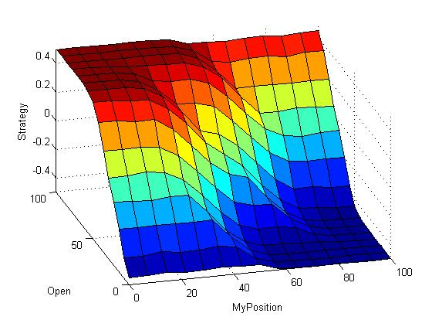
Back Strategy FIS Output
Notes:
Here is a graphical depiction of the back paddle’s strategy FIS output. One can see there are no discontinuities within the FIS file as the surface is very smooth.

Slide 25
Results – Singles Game
Game Number | Red Score | Blue Score | Winner
1 | 21 | 15 | R
2 | 13 | 21 | B
3 | 16 | 21 | B
4 | 19 | 21 | B
5 | 19 | 21 | B
6 | 21 | 18 | R
7 | 15 | 21 | B
8 | 12 | 21 | B
9 | 21 | 18 | R
10 | 21 | 16 | R
Total | 178 | 193
Red Wins: 4
Blue Wins: 6
Difference: 7.78%
Notes:
I had the singles robots play an arbitrary 10 games to show their abilities are equal. From these results we can find a 7.78% difference between the scores, which is low enough that if we were to play 1000 or even 10,000 games we would expect the difference to be insignificant.

Slide 26
Results – Doubles Game
Game Number | Red Team | Blue Team | Winner
1 | 21 | 20 | R
2 | 21 | 20 | R
3 | 17 | 21 | B
4 | 16 | 21 | B
5 | 21 | 19 | R
6 | 20 | 21 | B
7 | 21 | 18 | R
8 | 21 | 16 | R
9 | 20 | 21 | B
10 | 15 | 21 | B
Total | 193 | 198
Red Team Wins: 5
Blue Team Wins: 5
Difference: 2.53%
Notes:
I also ran 10 games of doubles pong, which shows this same small difference, meaning both teams share equal ability.

Slide 27
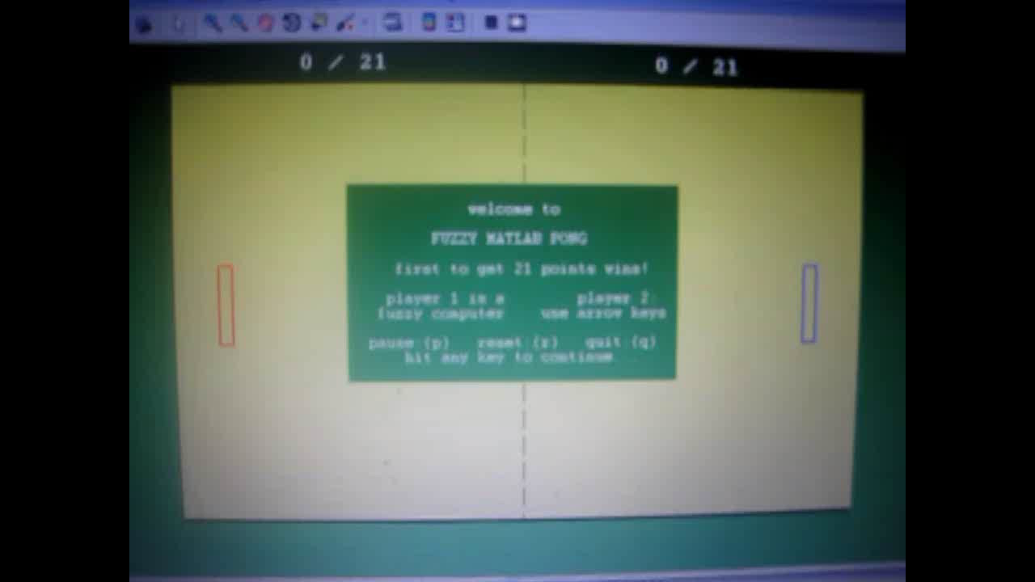
Notes:
Here is a short clip of two fuzzy robots playing PONG. Notice how they try to hit the ball to where the other one is not, and where the other one is not heading.

Slide 28
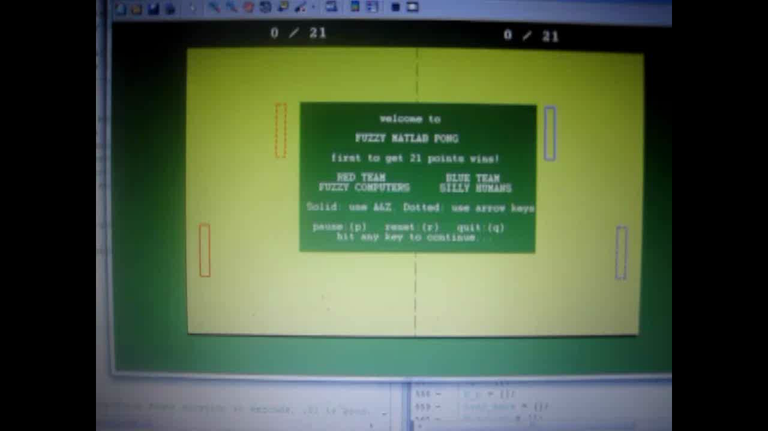
Notes:
Here is a video of two fuzzy robots playing a double’s game of PONG.

Slide 29

Conclusion
Fuzzy logic is an effective means of imitating human decision making skills in both single and doubles games.
Both versions are very difficult to beat
Collaborators are working on beta testing which could further improve performance.
http://wiki.hl7.org/images/8/83/Arb_work_in_progress.jpg
Notes:
From this research we could conclude that fuzzy logic is an effective means of imitating human reasoning and collaboration in the game of PONG. Currently I have collaborators working on beta testing to further improve FLIP’s performance.

Slide 30
Recommendations
GOOD PLAYER
Human or Robotic Team B
Robotic Team A
Robotic Coach
Notes:
Future work will include having a weak robotic team play against a human or good robotic team, while also being coached by an observing robot. A success would be considered when the weak robotic player could be coached into a better player than original “good” team.

Slide 31
Type 2 Fuzzy System
Brings uncertainty into the membership functions of a fuzzy set
Linguistic uncertainties can be modeled that were not visible in Type 1 fuzzy sets
Allows for more noisy measurements to be quantified
Notes:
To do this new development, I have adopted what are called type-2 fuzzy systems. A type 2 fuzzy system brings uncertainty into the membership functions by making each membership function a fuzzy area rather than a line as seen in a type 1 fuzzy set. This allows for even more layered, noisy, arbitrary reasoning to be imitated, like what you would find in a coach who is trying to create a better player.

Slide 32
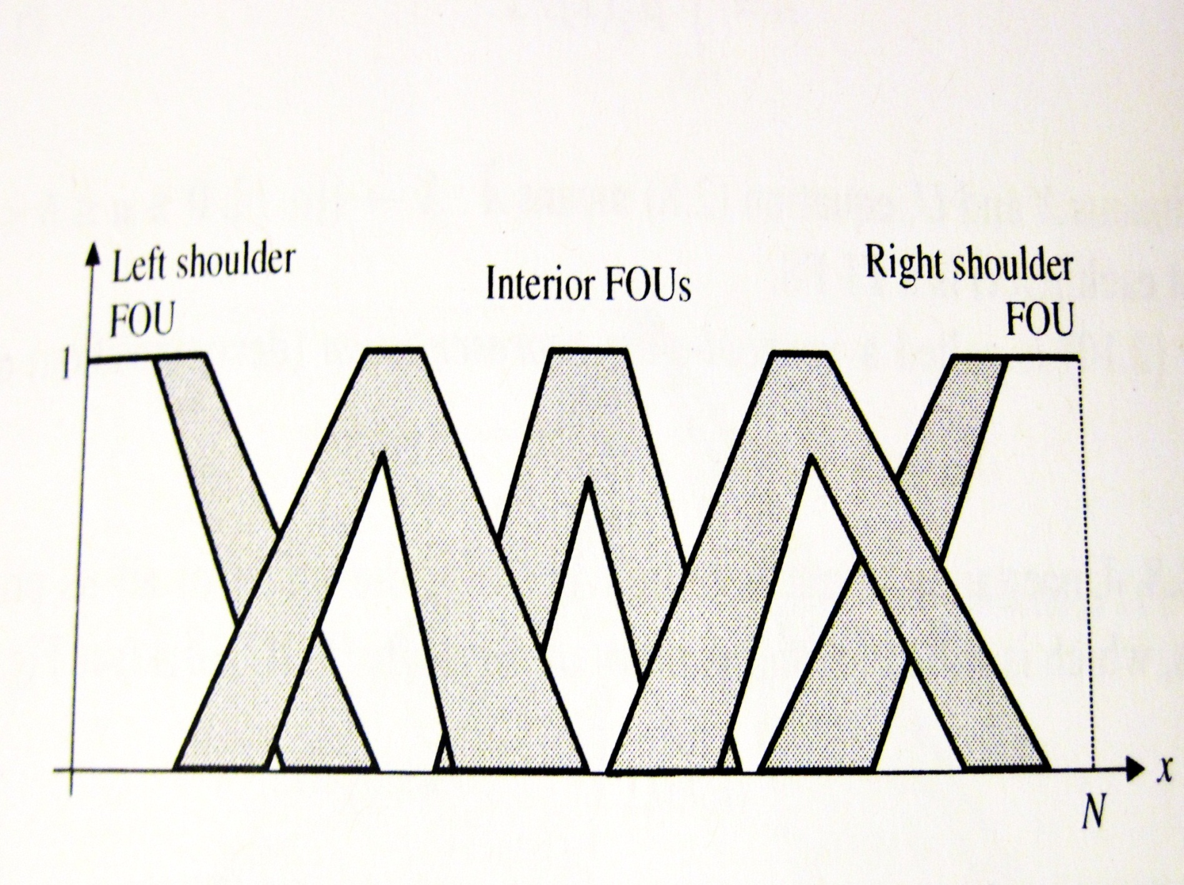
Example of Type 2 Fuzzy membership functions
Notes:
This image shows what I meant by having the membership functions fuzzy areas rather than lines. You can see if I were to draw a line through the center of each of these sets we would have a type 1 fuzzy set, but this allows for even fuzzier reasoning.

Slide 33
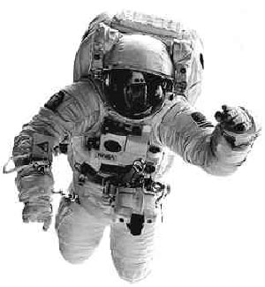
Future Plans
Continue research in aerospace engineering
Complete my Bachelors and Masters degrees through the ACCEND program at the University of Cincinnati
Pursue a PhD
NASA - JPL
Go to space.
Notes:
Moving on in my career, I hope to continue research in aerospace engineering, graduate from ACCEND with a Bachelors and Masters in aerospace engineering, and pursue a PhD. I hope to eventually work in the aerospace robotics field and be like this girl and go to space.

Slide 34
Acknowledgements
UC WISE Summer REWU program
Dr. Kelly Cohen
Cody Lafountain
MOST-Aerospace Labs
Notes:
I’d like to thank the UC WiSE REWU program for making this experience possible, my mentor Dr. Kelly Cohen because he’s awesome, Cody Lafountain for his help where I had problems, and MOST-Aerospace Labs.

Slide 35
References
2010 Australian Open – Men’s Doubles Final Bob & Mike Bryan vs. Nestor & Zimonjic [video]. Retrieved June, 2011, from http://www.youtube.com/watch?v=0C-pEt8d9ts
Barker, S., Sabo, C., and Cohen, K., "Intelligent Algorithms for MAZE Exploration and Exploitation", AIAA Infotech@Aerospace Conference, St. Louis, MO, March 29-31, 2011, AIAA Paper 2011-1510.
D. Buckingham, Dave’s MATLAB Pong, University of Vermont, Matlab Central, 2011
Federer & Mirka vs. Hewitt & Molik – part 3 [video]. Retrieved June, 2011, from http://www.youtube.com/watch?v=b0BAh_pRRTo
Sng H.L., Sen Gupta and C.H. Messom, Strategy for Collaboration in Robot Soccer, IEEE International Workshop on Electronic Design, Test and Applications (DELTA), 2002
B. Innocenti, B. Lopez and J. Salvi, A Multi-Agent Architecture with Cooperative Fuzzy Control for a Mobile Robot, Robotics and Autonomous Systems, vol. 55, pp. 881-891, 2007
D. Matko, G. Klancar and M. Lepetic, A Tool for the Analysis of Robot Soccer Game, International Journal of Control, Automation and Systems, vol. 1, pp. 222 – 228, 2003
New version amazing robot ASIMO [video]. Retrieved June, 2011, from http://www.youtube.com/watch?v=Q3C5sc8b3xM
Notes:
Here are my references

Slide 36
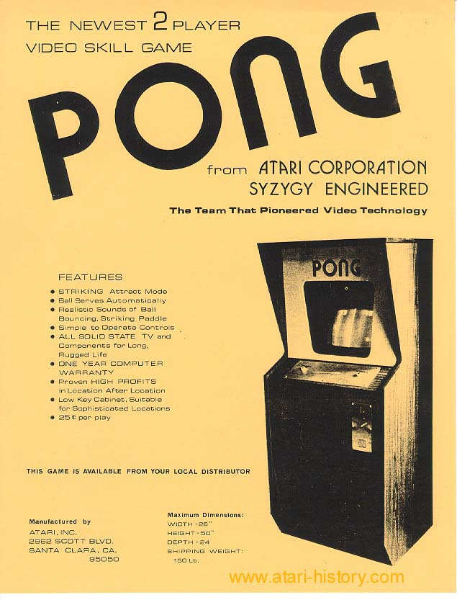
Questions?
Notes:
Any questions?

